Slide 1
Nguyen et al. (2023 )“Influence of temperature and precipitation on the effectiveness of water, sanitation, and 2 handwashing interventions against childhood diarrheal disease in rural Bangladesh: a re-analysis of a randomized control trial” . Preprint doi: https://doi.org/10.1101/2022.09.25.22280229
Our paper | Nguyen et al. 2023
Research Question | Research Question
innovate a method for extracting water extents over time that better link to longitudinal health outcomes, Establish the relationship between flood patterns and dietary outcomes across seasons, and further assess the impacts of a HFP intervention on this relationship, in the Haor basin. | Assess whether temperature and precipitation modified the effect of water, sanitation, and handwashing interventions on child diarrhoea prevalence in a randomized trial in rural Bangladesh.
Outcomes (12): Women’s dietary diversity (continuous) & food group consumption (binary) | Outcomes (1): Child diarrhoea prevalence (binary)
Exposures (1): Flooding (continuous; area of cluster submerged in water above “normal”) | Exposures (5): Interventions (binary) – Water only; sanitation only; handwashing only; combined WASH; any WASH
Effect Modifiers (2): Season (nominal); Household Food Production intervention (binary) | Effect Modifiers (2): temperature (continuous); precipitation (continuous)
Other: The Habiganj and Sunamganj districts of rural Bangladesh (2015-2019; n=2,620 women) | Other : The Gazipur, Kishoreganj, Mymensingh, and Tangail districts of rural Bangladesh (2012-2013; n=6,921 children)
Methods | Methods
Only included women enrolled at baseline 3-way interaction: Linear and log mixed effects models to model outcomes as function of flooding, modified by season and trial-arm. Flooding has a log distribution, so it was centred and scaled The relationship between flooding and dietary diversity is non-linear, until season is accounted for. | Intention-to-treat-approach (all participants included?) Potential non-linear relation: Generalized additive models (GAMs) used to model the outcomes as a function of the intervention and an environmental variable (as a spline). Specified a binomial family with logit link functions and used restricted maximum likelihood estimation (REML) smoothing parameters. Estimated simultaneous confidence intervals using a parametric bootstrap of the variance-covariance matrix under a multivariate normal distribution

Slide 2
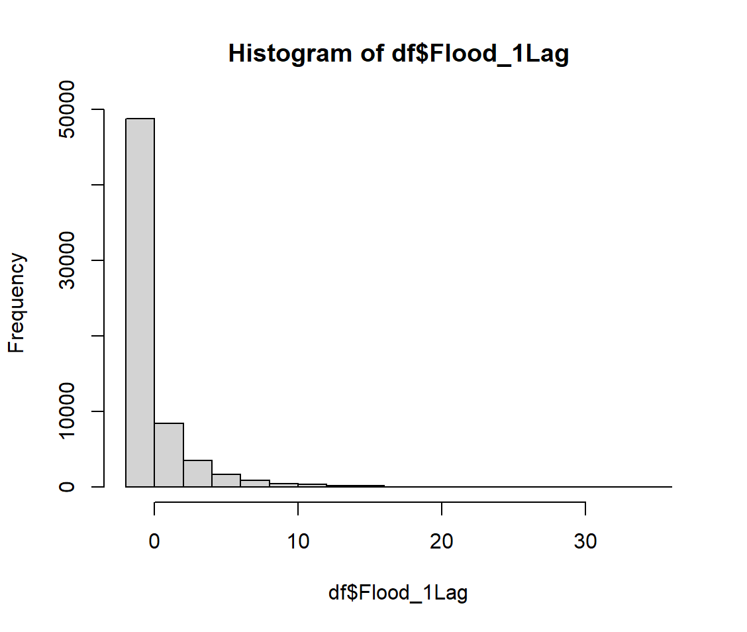
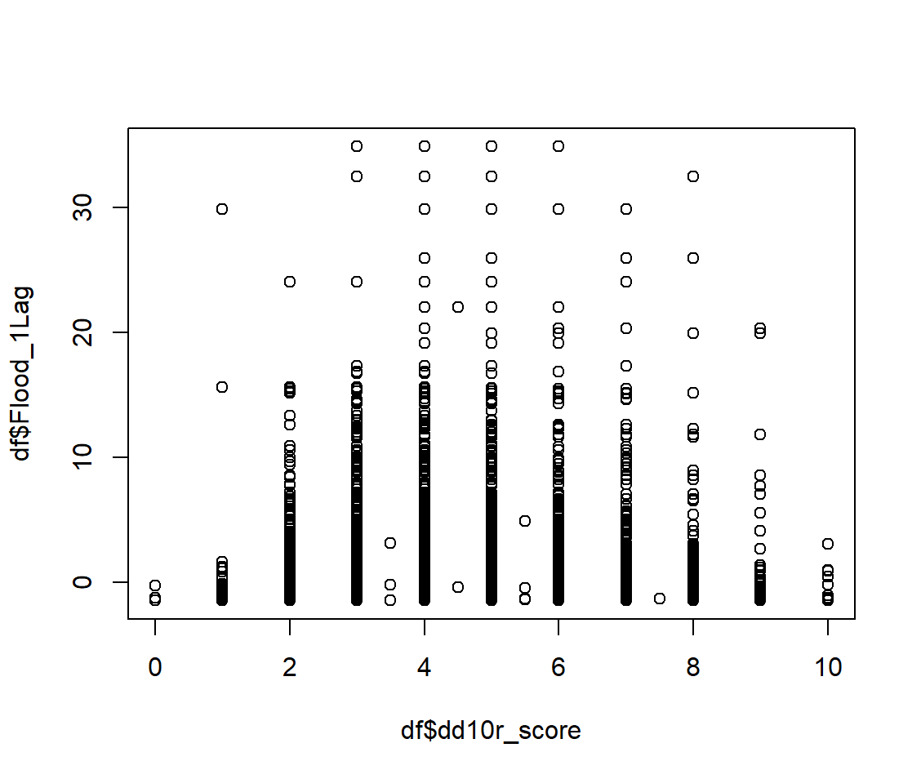
RAW DATA
Distribution: % cluster covered by water
Scatterplot: Dietary diversity vs. flooding
Flood_1Lag = (perc_flooded-mean_value)/0.01
Range:0-30 (1 unit = 1% cluster coverage)
Not a clear linear distribution
LINEAR MIXED EFFECTS MODEL
lme(dd10r_score_m ~ Flood_1Lag * season_flood * treatment
+ dd10r_score_m_BL + ramadan + g_2h_BL + quint2_BL,
random = list(wcode = pdDiag(~1|season_id), c_code = pdDiag(~1)), weights = varIdent(form = ~ 1 | wdiet_wt),
na.action = na.omit, data= df) # Family=‘gaussian’
Does this account for main effects? How do I access them? Are different strata accessible? Doesn’t seem it
GENERALISED ADDITIVE MODELS
gam(dd10r_score_m ~ ti(Flood_1Lag, by=int_3) + factor(treatment) + season_flood
+ dd10r_score_m_BL + factor(ramadan) + factor(g_2h_BL) + factor(quint2_BL),
random = list(wcode = pdDiag(~1|season_id), c_code = pdDiag(~1)), weights = wdiet_wt,
family="gaussian", method = "REML", na.action=na.exclude, data = df)

Slide 3
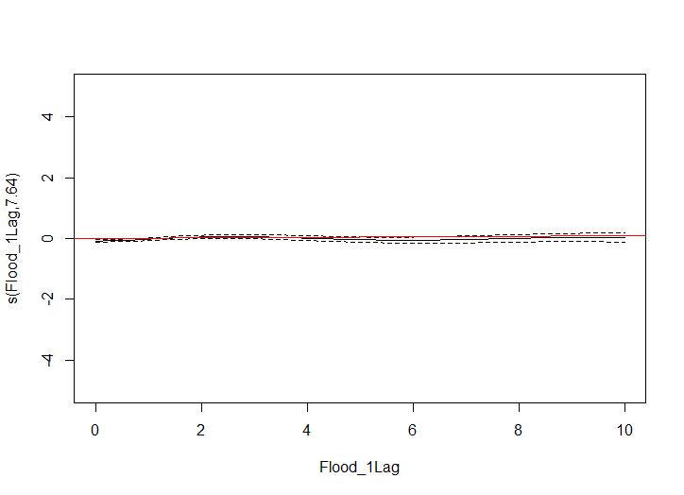
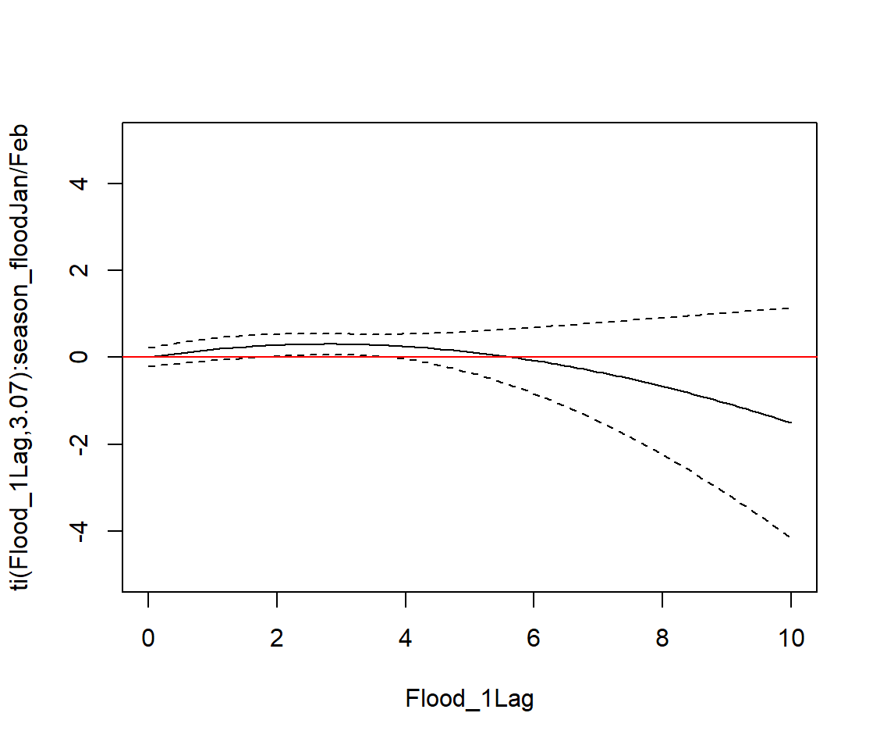
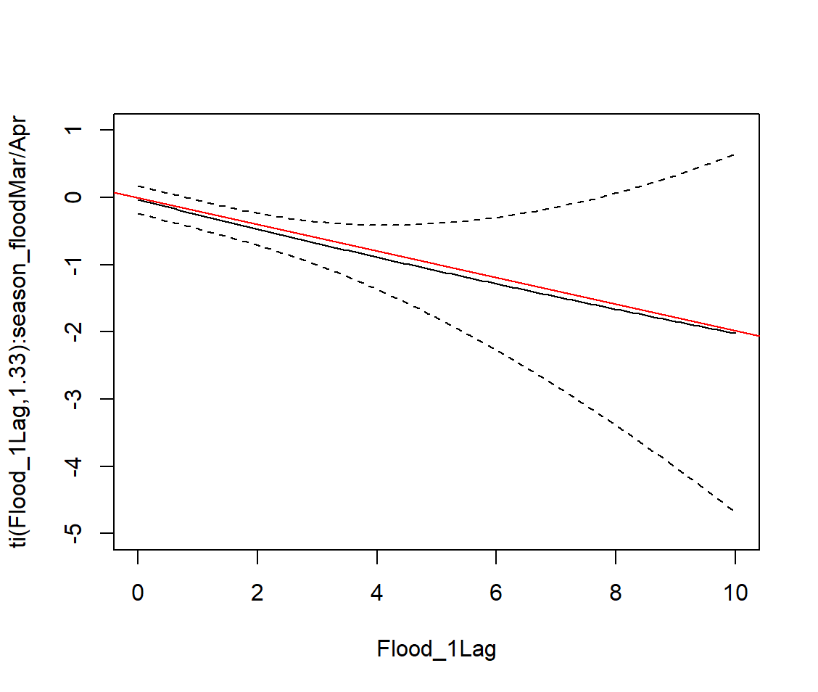
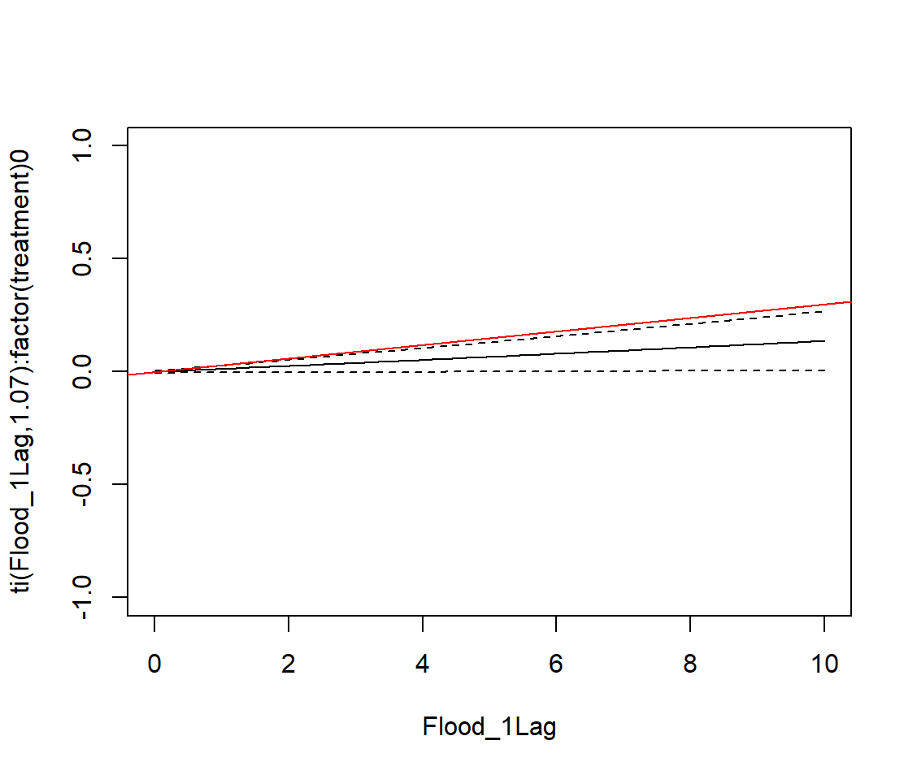
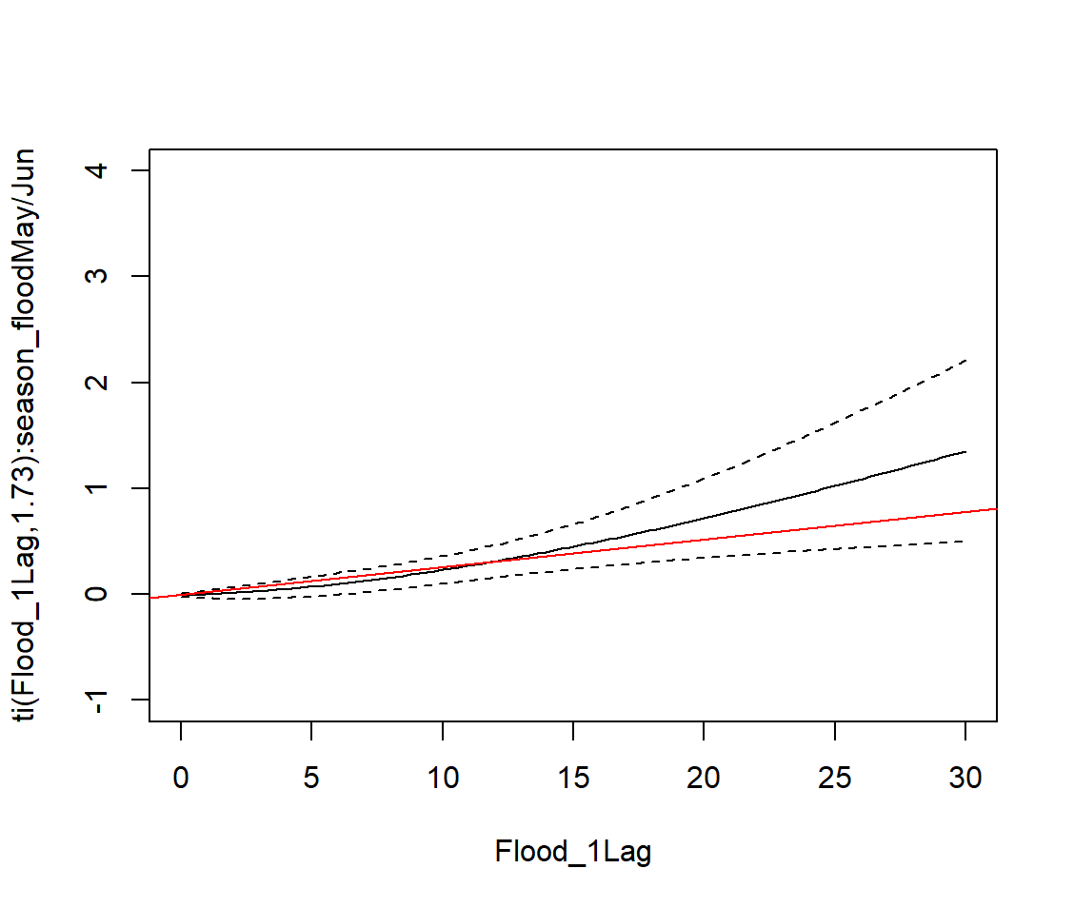
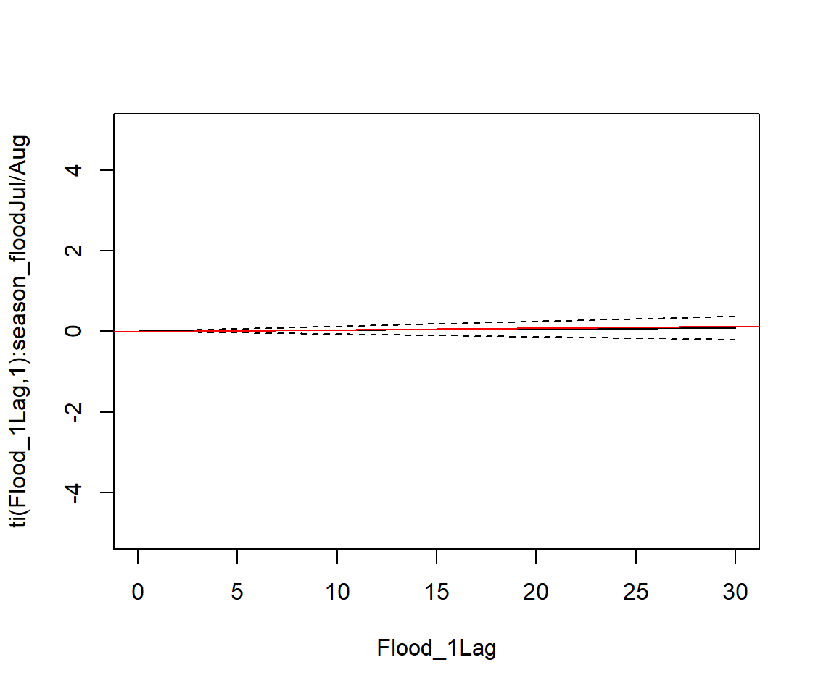
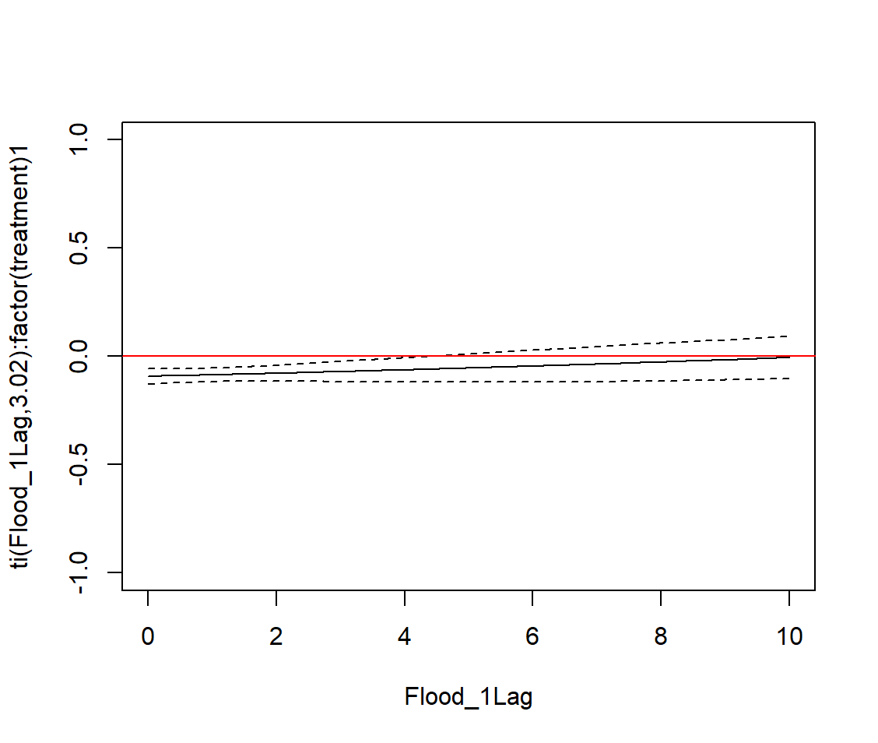
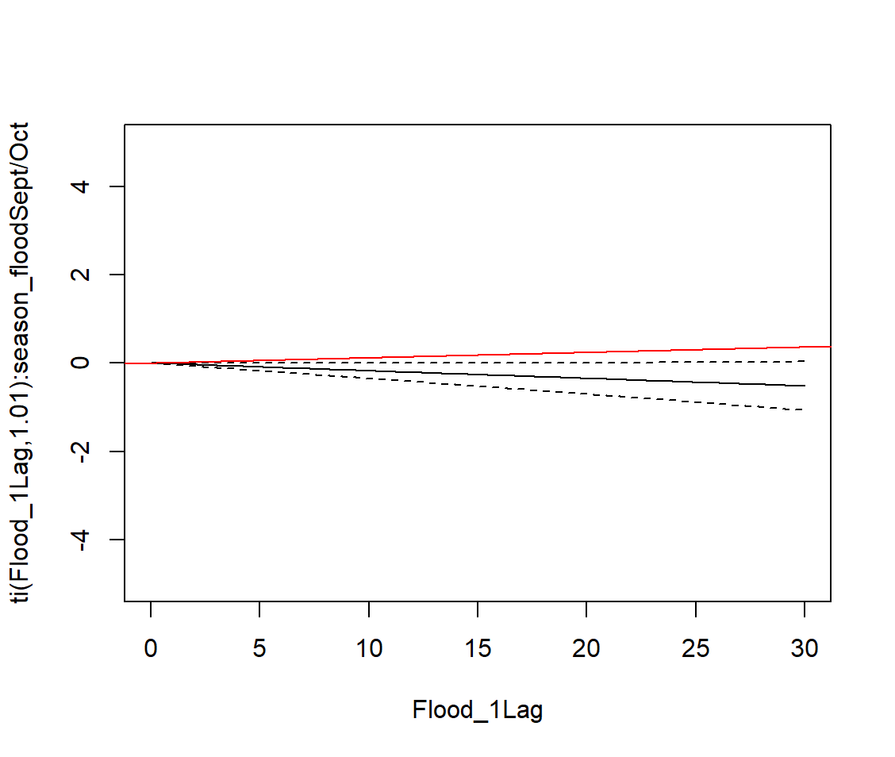
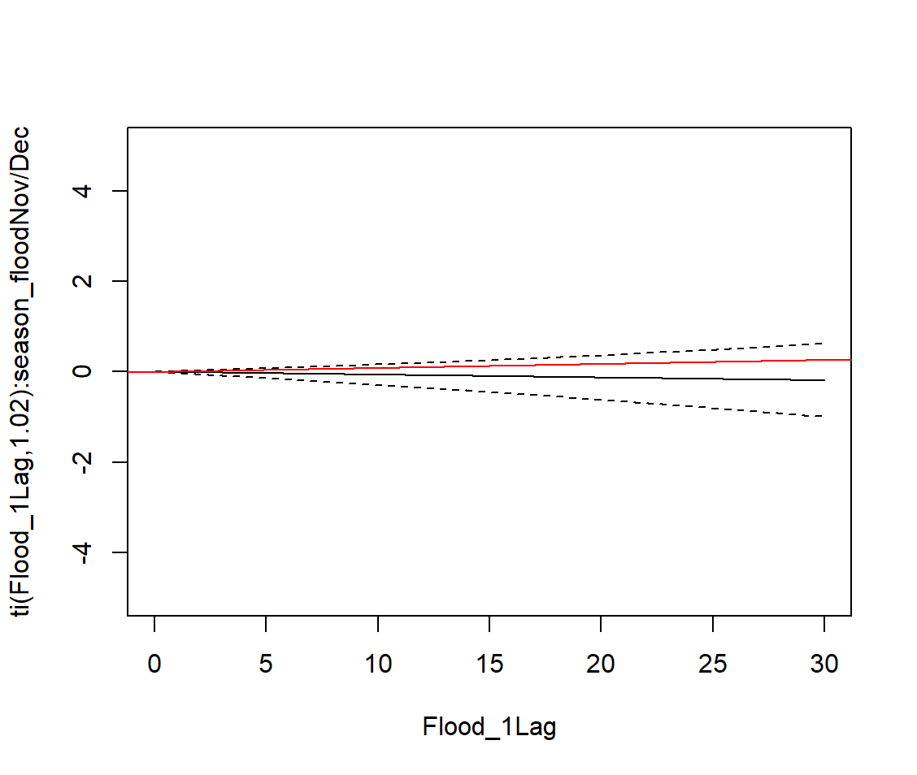
GAM Model Sensitivity Checks:
Black is GAM spline outputs; Red is the respective slope provided from the LME marginal effects
F1: Pooled effects (no interaction)
F2: Pooled seasonal effects (seasonal interaction)
Jan/Feb
P>0.05
*P<0.05
Mar/Apr
*P<0.05
*P<0.05
Quadratic effect is present in some seasons, but it is telling the same story
F3: Trial effects (HFP interaction)
Cont.
*P<0.05
*P<0.05
May/Jun
*P<0.05
*P<0.05
Jul/Aug
P>0.05
P>0.05
Not sure why the intercept is not 0… does this account for main effects? If so, why is it not positive?
Treat.
P>0.05
*P<0.05
Sep/Oct
P>0.05
*P<0.05
Nov/Dec
P>0.05
P>0.05

Slide 4
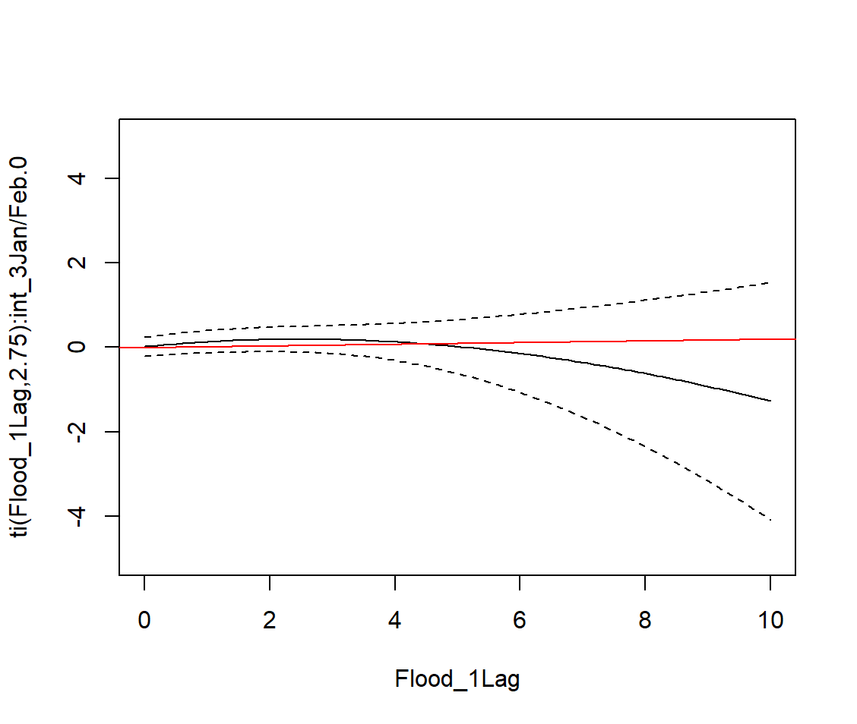
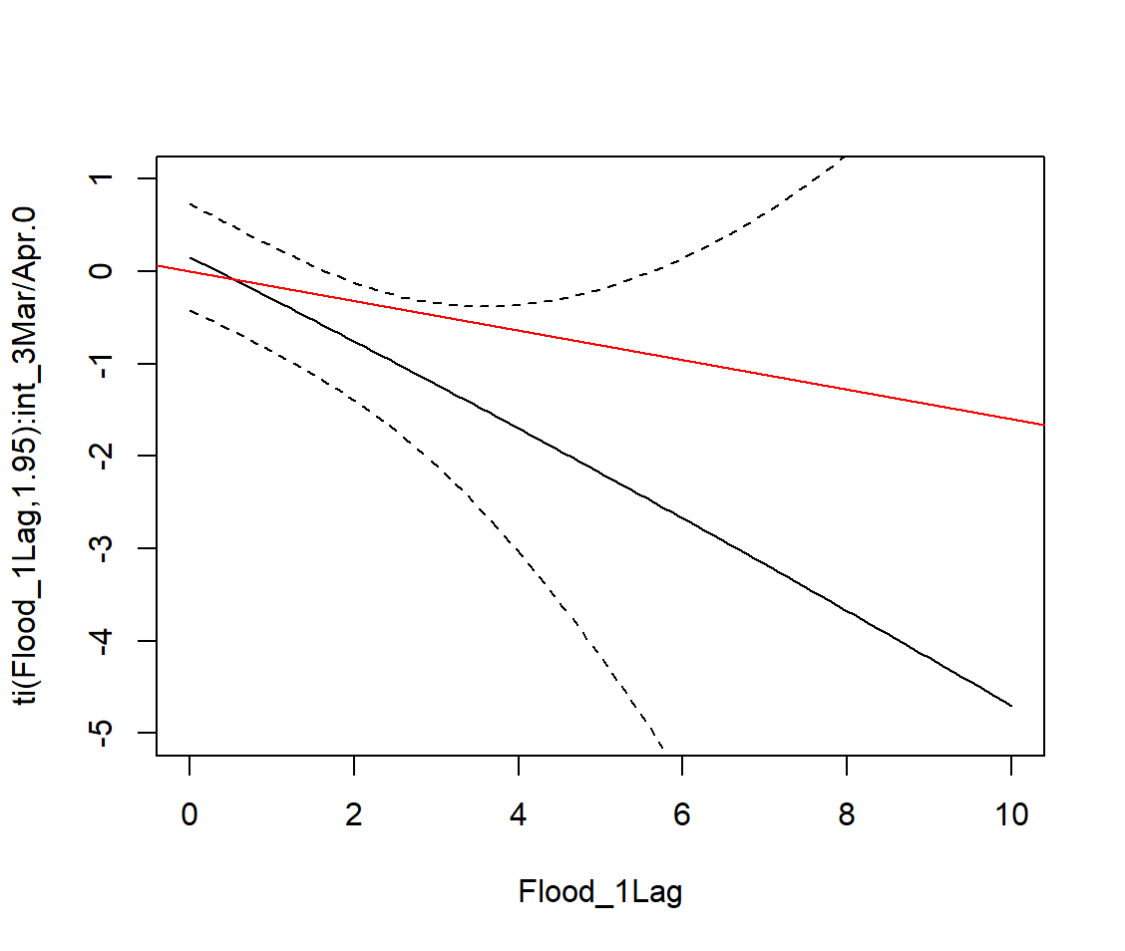
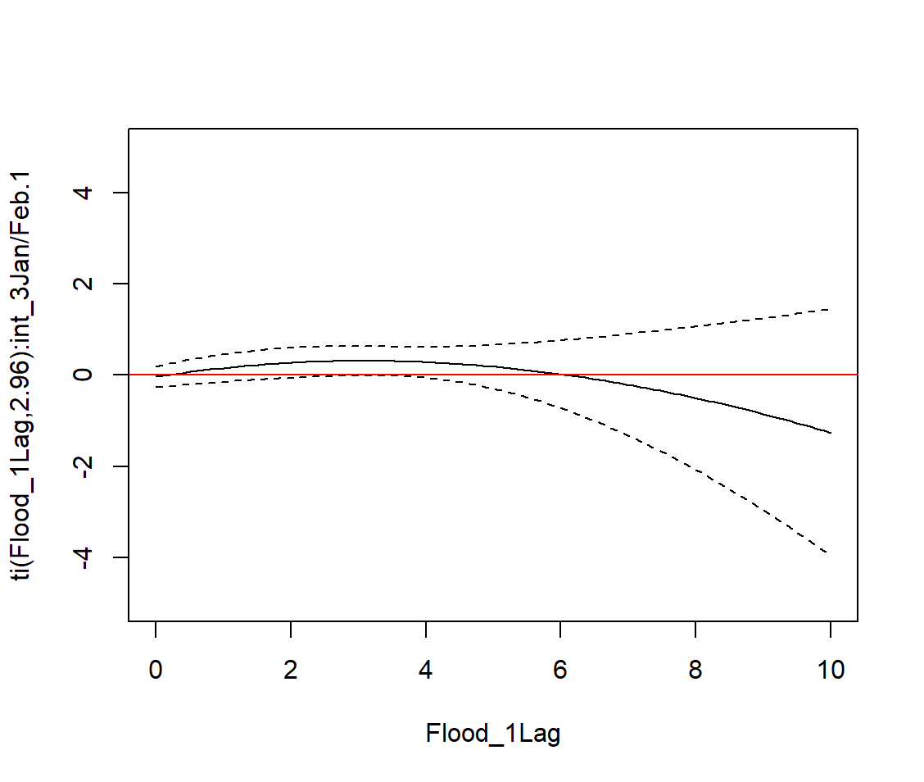
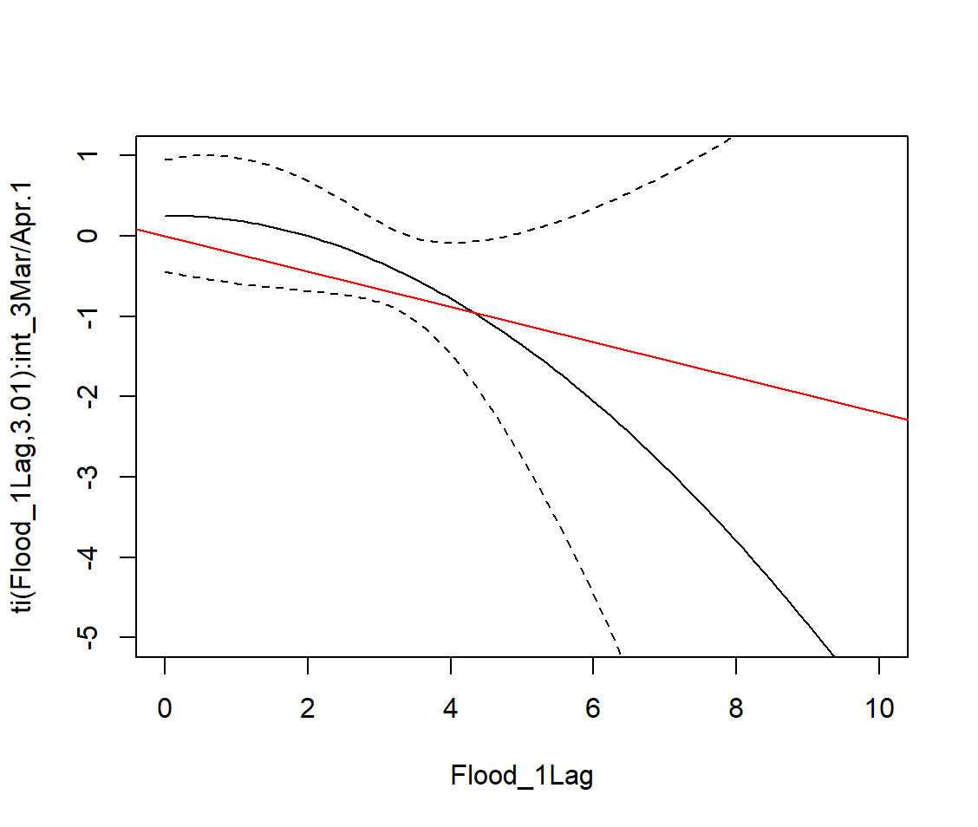
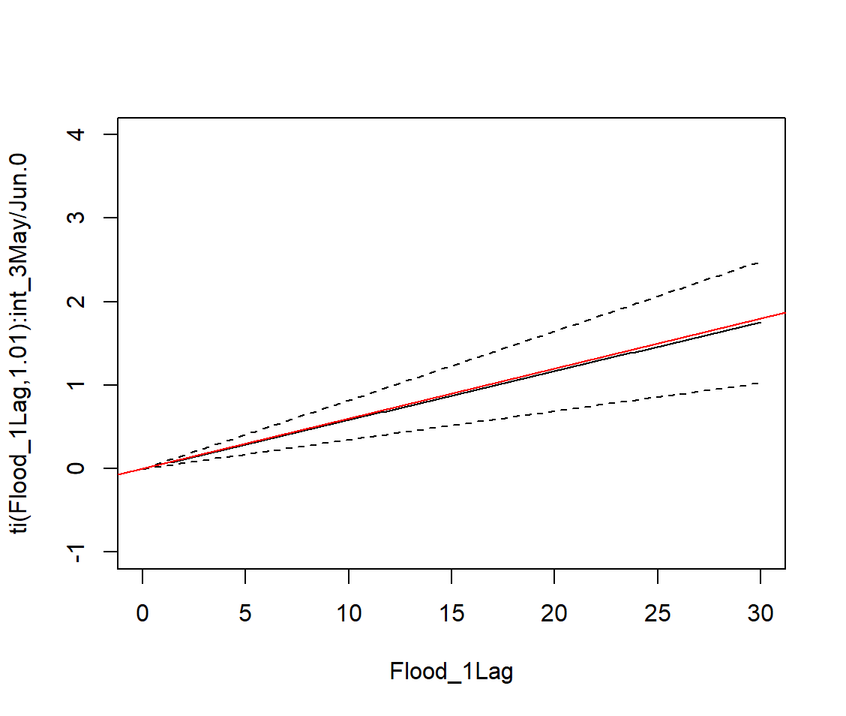
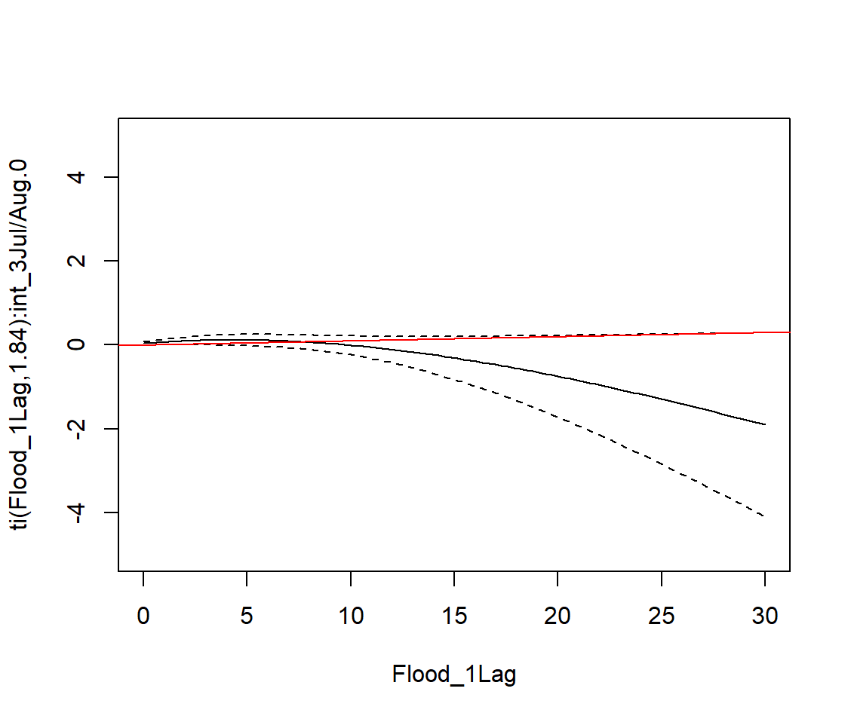
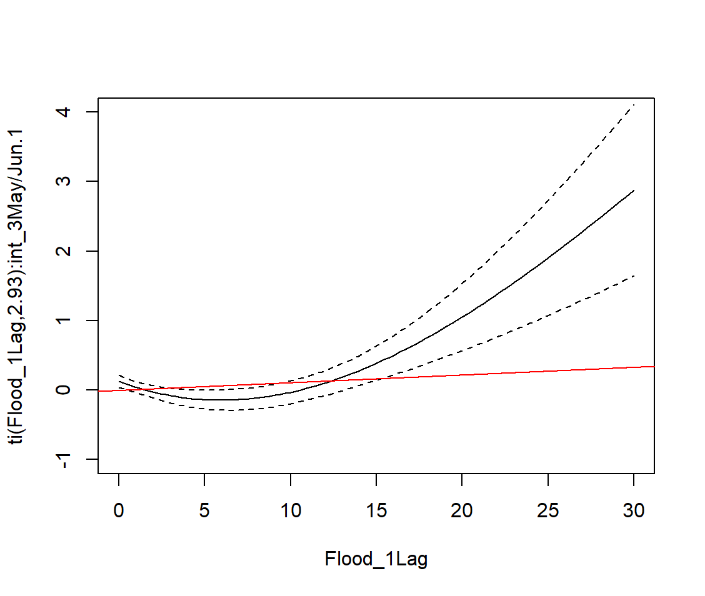
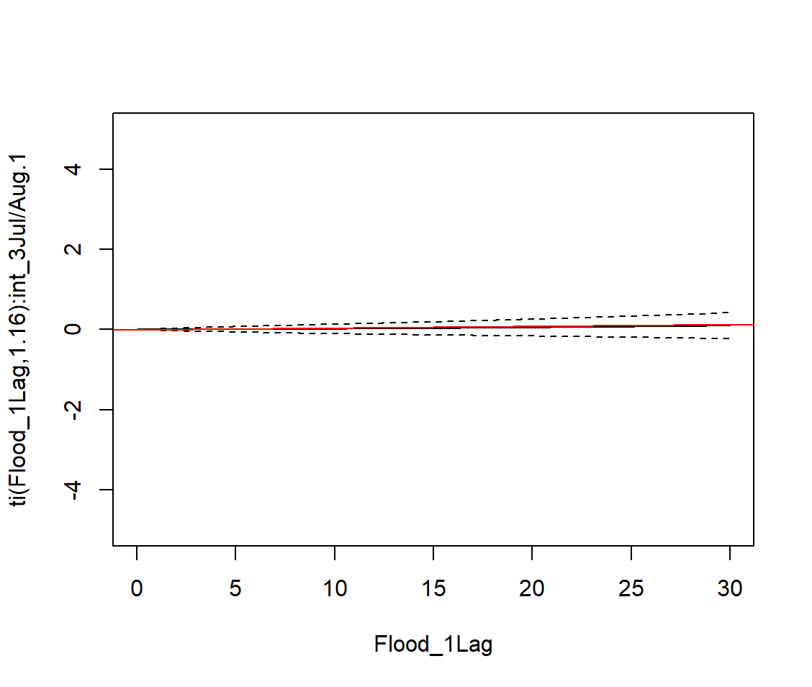
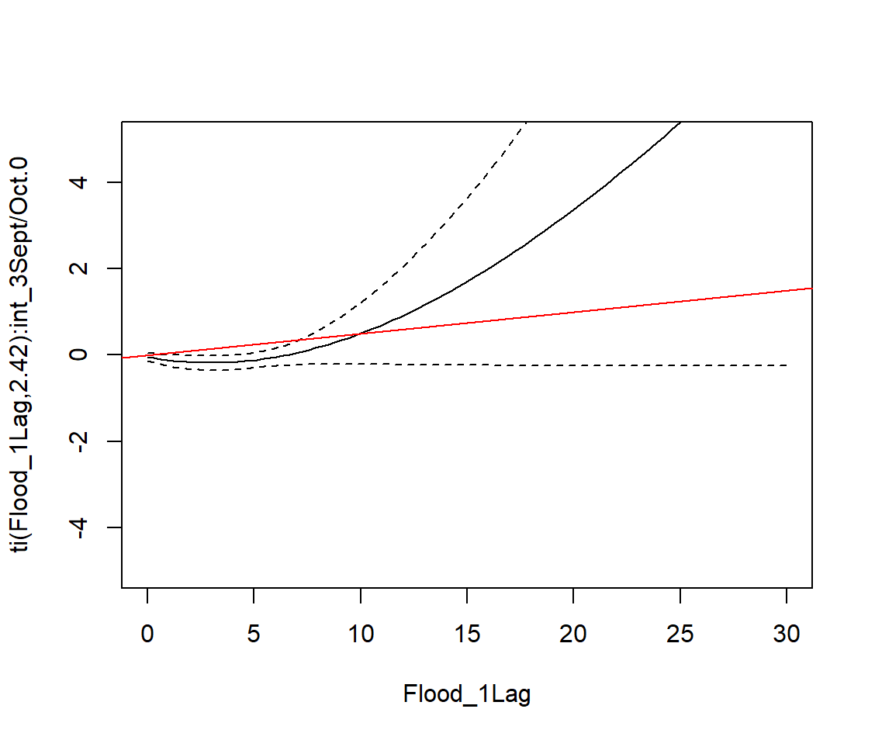
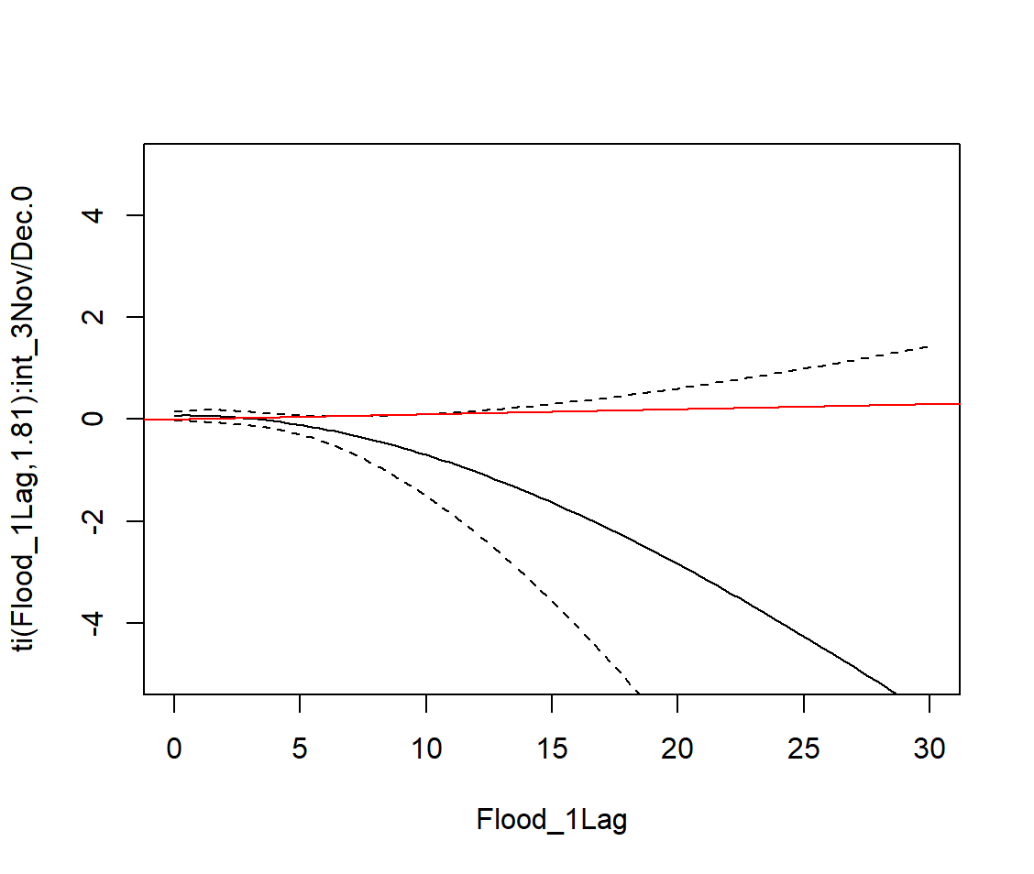
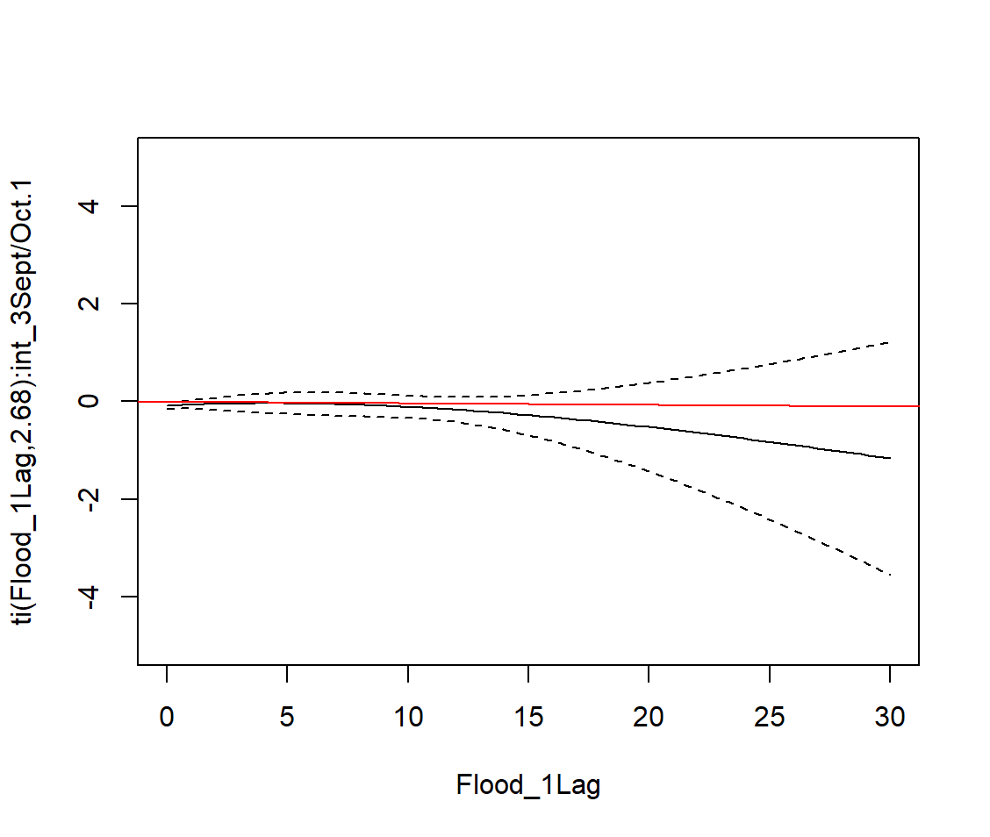
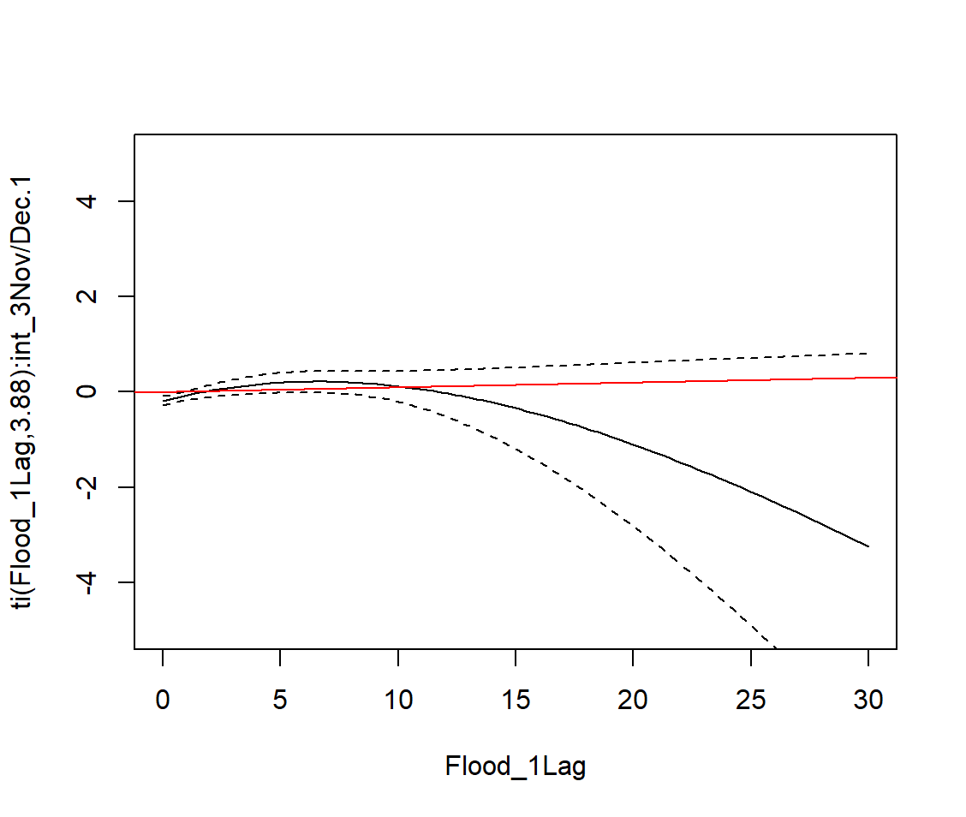
GAM Model Sensitivity Checks:
Black is GAM spline outputs; Red is the respective slope provided from the LME marginal effects
NB: The dotted lines are SE’s, not CI’s (those need to be bootstrapped). These are SE’s, which calculated the p values (a complicated process).
F4: Seasonal trial-effects (flood by season*trial)
C. Jan/Feb
P>0.05
P>0.05
P>0.05
*P<0.05
T. Jan/Feb
P>0.05
*P<0.05
*P<0.05
*P<0.05
C.Mar/Apr
T.Mar/Apr
C.May/Jun
*P<0.05
*P<0.05
C.Jul/Aug
P>0.05
P>0.05
T.May/Jun
P>0.05
*P<0.05
T.Jul/Aug
P>0.05
P>0.05
C.Sep/Oct
C.Nov/Dec
P>0.05
P>0.05
T.Sep/Oct
P>0.05
*P<0.05
T.Nov/Dec
P>0.05
*P<0.05
*P<0.05
P>0.05

Slide 5
GAM Model Sensitivity Checks:
Black is GAM spline outputs; Red is the respective slope provided from the LME marginal effects
F4: Seasonal trial-effects (flood by season*trial)
C. Jan/Feb
P>0.05
P>0.05
P>0.05
*P<0.05
T. Jan/Feb
P>0.05
*P<0.05
*P<0.05
*P<0.05
This is a more extreme decrease than initial model
C.Mar/Apr
T.Mar/Apr
C.May/Jun
*P<0.05
*P<0.05
C.Jul/Aug
P>0.05
P>0.05
T.May/Jun
P>0.05
*P<0.05
T.Jul/Aug
P>0.05
P>0.05
The wide standard errors reflect what we know about the data (there are no values >4% in Mar/Apr)
This seems to suggest that the HFP acts as a buffer to the impacts of flooding on diets
C.Sep/Oct
C.Nov/Dec
P>0.05
P>0.05
T.Sep/Oct
P>0.05
*P<0.05
T.Nov/Dec
P>0.05
*P<0.05
*P<0.05
P>0.05

Slide 6
GAM Model Sensitivity Checks:
Black is GAM spline outputs; Red is the respective slope provided from the LME marginal effects
F4: Seasonal trial-effects (flood by season*trial)
C. Jan/Feb
P>0.05
P>0.05
P>0.05
*P<0.05
T. Jan/Feb
P>0.05
*P<0.05
*P<0.05
*P<0.05
This seems to suggest that the HFP acts as a buffer to the impacts of flooding on diets
This matches well to the initial model
C.Mar/Apr
T.Mar/Apr
C.May/Jun
*P<0.05
*P<0.05
C.Jul/Aug
P>0.05
P>0.05
T.May/Jun
P>0.05
*P<0.05
T.Jul/Aug
P>0.05
P>0.05
C.Sep/Oct
C.Nov/Dec
P>0.05
P>0.05
T.Sep/Oct
P>0.05
*P<0.05
T.Nov/Dec
P>0.05
*P<0.05
*P<0.05
P>0.05

Slide 7
GAM Model Sensitivity Checks:
Black is GAM spline outputs; Red is the respective slope provided from the LME marginal effects
F4: Seasonal trial-effects (flood by season*trial)
C. Jan/Feb
P>0.05
P>0.05
P>0.05
*P<0.05
T. Jan/Feb
P>0.05
*P<0.05
*P<0.05
*P<0.05
C.Mar/Apr
T.Mar/Apr
C.May/Jun
*P<0.05
*P<0.05
C.Jul/Aug
P>0.05
P>0.05
T.May/Jun
P>0.05
*P<0.05
T.Jul/Aug
P>0.05
P>0.05
Doesn’t seem like a notable difference considering that there are no values >7 for Jan/Feb
C.Sep/Oct
C.Nov/Dec
P>0.05
P>0.05
T.Sep/Oct
P>0.05
*P<0.05
T.Nov/Dec
P>0.05
*P<0.05
*P<0.05
P>0.05

Slide 8
GAM Model Sensitivity Checks:
Concern 1: Cannot tell how these models calculate interactions, I can see no obvious main effects, just marginal ones.
The models can only take one categorical variable at a time, not 2
I can see no way of deconstructing the interaction (i.e. only look at season, or treatment), I had to force the 3-way with a new categorical variable
Nguyen et al. (2023 ) model seems more like a stratification analysis than an interaction/effect modification analysis (see below):
new_fit = mgcv::gam(yname~ s(risk_factor, by = tr),
family = "binomial",
data = data,
method = "REML",
select = TRUE,
na.action=na.exclude,
random = ~(1|clusterid))
Concern 2: Does using a non-linear model really give us something more/better? When the GAM model is configured like the LMER, we get something very similar to the linear relationship identified by the LMER. Changing models will set us back and I don’t think it will change our interpretation much.

